Slide 1
ЧПУ Delta Electronics
G-коды. Примеры
Notes:
DELTA CNC CONTROLLER_NC-300 PRODUCT FUNDAMENTAL INTRODUCTION
Delta CNC Controller_NC-300 Product Fundamental Introduction

Slide 2
СОДЕРЖАНИЕ
Таблица G-кодов
M команды
Макропеременные

Slide 3
Таблица G-кодов

Slide 4
Таблица G-кодов

Slide 5
Таблица G-кодов

Slide 6
Формат команд G-кодов
G00: Ускоренное перемещение инструмента (холостой ход)
Формат команды: G00 XˍYˍZˍ (Эта команда может перемещать сразу 3 оси
, или же каждую ось по-отдельности.)
XˍYˍZˍ: Координаты конечной точки.
Максимальная скорость перемещения 15м/мин.
Фактическая скорость движения под разными клавишами быстрой подачи настройки может быть :
(1). 15 м/мин, максимальная скорость, когда установлено значение 100%;
(2). 7.5 м/мин при значении 50%;
(3). 3.75 м/мин при значении 25%;
(4). Ось перемещается со скоростью, заданной параметрами, когда значение настройки равно 0%.

Slide 7
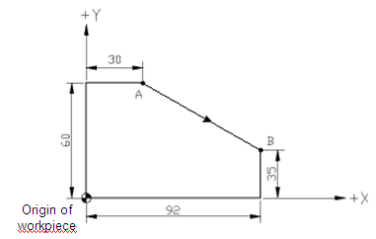
Формат команд G-кодов
[Illustrations]
See figure below for moving cutters from point A to point B at fast speed.
Expressed in absolute values: G90 G00 X92. Y35.
Expressed in incremental values: G91 G00 X62. Y-25.

Slide 8
Формат команд G-кодов
G01: Linear Cutting Command
Формат команды:G01 XˍYˍZˍFˍ
XˍYˍZˍ: End point coordinates.
Fˍ: Feed rate in unit of mм/мин
Command description:
This command enables a cutter to linear cut from the current position to a given position at F feed rate. The ending position of the cutting is given by the X, Y, and Z coordinates.
The feed rate is set by the F parameter along with the optional Feed Rate of the secondary control panel in unit of mm/ min.

Slide 9
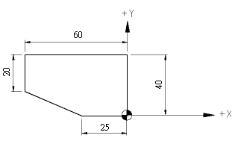
Формат команд G-кодов
[Illustrations]
Regarding the method of G01, see figure below for milling in direction of +Y from program origin.
G00 G90 G54 X0 Y0
G90 G01 Y40.0 F80
X-60.0
G91 Y-20.0
X35.0 Y-20.0
G90 X0 Y0
The F parameter remains active unless being changed as shown in program codes listed above where the F parameters are omitted in subsequent statements.

Slide 10
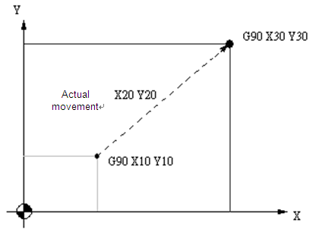
Формат команд G-кодов
G90: Absolute Coordinate System Command
Command syntax: G90 Xˍ Yˍ Zˍ
[Illustrations]
From point 1 of coordinates (X10,Y10) to point 2 (X30,Y30), the tool moves an actual distance of X20 and Y20 as shown in the figure below.
O1000
G01 G90 X10.0 Y10.0 F500.0
X30.0 Y30.0
Notes:
The most commonly used

Slide 11
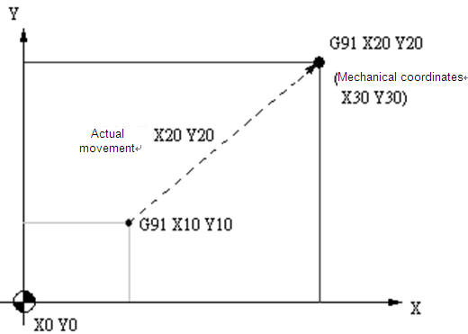
Формат команд G-кодов
G91: Incremental Coordinate System Command
Формат команды: G91 Xˍ Yˍ Zˍ
[Illustrations]
From point 1 of coordinates (X10, Y10) to point 2 (X20, Y20) the tool moves an actual distance of X20 and Y20 to point (X30, Y30) of the actual mechanical coordinates as shown in the figure below.
O1001
G01 G91 X10.0 Y10.0 F500.0
X20.0 Y20.0

Slide 12
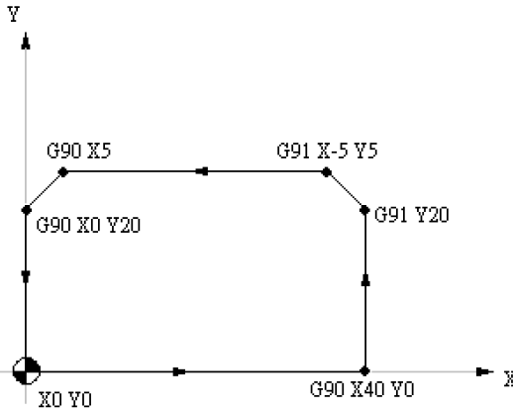
Формат команд G-кодов
Example of using G90 and G91 commands together:
O0010
G01 G90 X0 Y0 F1000
X40.0
G91 Y20.0
X-5.0 Y5.0
G90 X5.0
X0 Y20.0
Y0
M30

Slide 13
Формат команд G-кодов
G54~G59: Workpiece Coordinate System Selection Command
Формат команды:
G90 G54 Xˍ Yˍ Zˍ or;
G90 G55 Xˍ Yˍ Zˍ or;
G90 G56 Xˍ Yˍ Zˍ or;
G90 G57 Xˍ Yˍ Zˍ or;
G90 G58 Xˍ Yˍ Zˍ or;
G90 G59 Xˍ Yˍ Zˍ
A workpiece coordinates system is created by moving the tool from the mechanical origin to the desired program origin (with proper X and Y distance), registering this position data in the workpiece coordinates system setup (G54~G59) in the controller OFS group function, and executing the workpiece
coordinates system code, then you can set up the workpiece coordinates origin.
The system also features a designation function out of 64 sets of expansive workpiece coordinates system options.
This is done by assigning values to argument P_ (with valid value range of 1~64) in command G54.
For example, G54 P10 X_ Y_ Z_. It means the tenth coordinates system of expanded workpiece coordinates system is used.

Slide 14
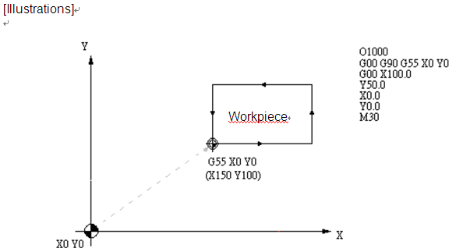
Формат команд G-кодов
Work reference point of G55 coordinate system , this point is decided based on user’s request.

Slide 15
Формат команд G-кодов
G28: Homing to the First Reference Point
Формат команды:G90 G28 Xˍ Yˍ Zˍ or;
G91 G28 Xˍ Yˍ Zˍ
Xˍ Yˍ Zˍ: Coordinates of reference point
Command description:
This command instructs the tool to fast move (G00) from the reference point given by the command to the mechanical origin.
It is designed to return to the mechanical origin by moving to the reference point given by the command to avoid any intersection with the workpiece or the machine equipment.
Notes:
Origin parameter

Slide 16
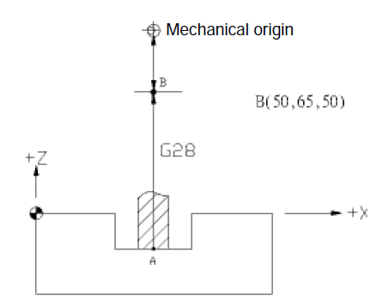
Формат команд G-кодов
G90 G28 Z50 → Return to mechanical origin from point A through reference point B (Z-axis).
M06 T02 → Switch to tool 2.
Notes:
Finally, it will return to the mechanical origin

Slide 17
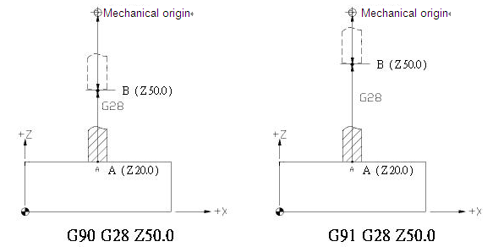
Формат команд G-кодов
[Illustrations]
Status of G90/G91 differs in the process of returning to the mechanical origin when command G28 is executed. See figure below for details.

Slide 18
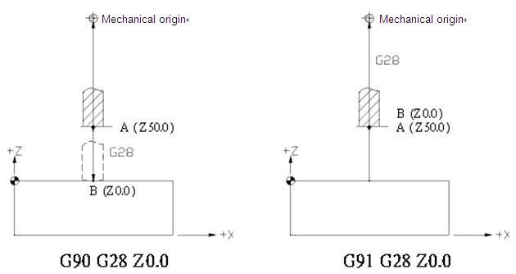
Формат команд G-кодов

Slide 19
Формат команд G-кодов
G02/G03: Arc Cutting Command
Arcs in the X – Y plane
G17 G02 (or G03) Xˍ Yˍ Rˍ Fˍ or
G17 G02 (or G03) Xˍ Yˍ Iˍ Jˍ Fˍ
You may add parameter Zˍ in the command to spiral move in the X – Y plane
.
Arcs in the Z – X plane
G18 G02 (or G03) Zˍ Xˍ Rˍ Fˍ or
G18 G02 (or G03) Zˍ Xˍ Kˍ Iˍ Fˍ
You may add parameter Yˍ in the command to spiral move in the Z – X plane.
Arcs in the Y – Z plane
G19 G02 (or G03) Yˍ Zˍ Rˍ Fˍ or
G19 G02 (or G03) Yˍ Zˍ Jˍ Kˍ Fˍ
You may add parameter Xˍ in the command to spiral move in the Y – Z plane.

Slide 20
Формат команд G-кодов
G02: Clockwise (CW) arc cutting.
G03: Counterclockwise (CCW) arc cutting.
X, Y, and Z: Coordinates of the end point in absolute or incremental values
determined by command G90 and G91.
R: Arc radius (expressed in the so-called Radius method).
I: The X-axis distance between arc center and starting point. The increment amount
from the starting point to arc center.
J: The Y-axis distance between arc center and starting point. The increment
amount from the starting point to arc center.
K: The Z-axis distance between arc center and starting point. The increment
amount from the starting point to arc center.
(The I, J, and K expression is also known as the Center method.)
F: The cut feeding speed in unit of mм/мин.

Slide 21
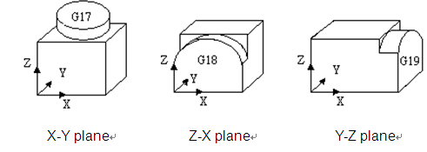
Формат команд G-кодов
Command description: G02 or G03 is the arc cutting command. The arc cutting direction (G02 or G03) for a three-dimensional workpiece in individual planes is shown in Figure 1. The cutting direction is defined by the right hand coordinate system. Look against the positive direction of the plane's vertical axis; G02 is for clockwise direction while G03 is for counterclockwise.

Slide 22
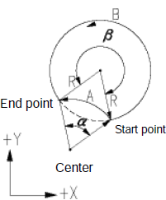
G02/G03: круговая интерполяция
Radius method:
R is the radius of the arc and shows in radius value. This method represents an arc by its starting point, ending point, and arc radius. There are two equivalent arcs in a circle as shown in the figure below. For the positive R value, it is an arc of central angle ≤ 180° and an arc of central angle > 180° for the negative R value.
β > 180° -> the B arc with negative R
α ≤ 180° -> the A arc with positive R
In the figure above if R = 50mm and the absolute coordinates of the end point are (100.0, 80.0), then
(1) the arc of central angle > 180° (path B) can be expressed as
"G90 G03 X100.0 Y80.0 R-50.0 F80" and;
(2) The arc of central angle ≤180° (path A) can be expressed as
"G90 G03 X100.0 Y80.0 R50.0 F80"

Slide 23
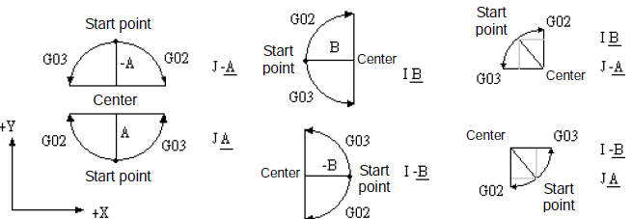
G02/G03: круговая интерполяция
Center method:
Here parameters I, J, and K define the relative distance from the arc start point to the arc center (the end point). That is, the increments from the start point to the center in X, Y, and Z directions respectively.
The arc motion expressed in the radius or center method can be used in program coding for selecting conditions.

Slide 24
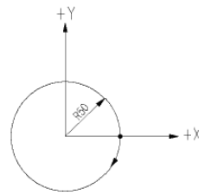
G02/G03: круговая интерполяция
To cut milling a sphere you can use the center but not the radius method.
Generating a sphere by connecting two semi-spheres bears too large a roundness deviation to be acceptable.
The command syntax for cut milling a sphere as shown in the figure
"G02 I-50.0".
Notes:
Full Circle

Slide 25
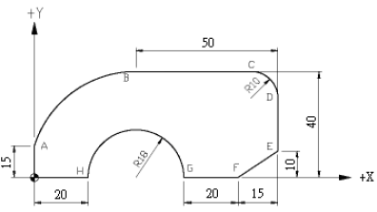
Задание

Slide 26
Формат команд G-кодов
Use of commands G01, G02, and G03 is illustrated in the figure below. Here is
the tool cut milling from program origin upward along the shape.
O0100
G90 G54 X0 Y0 S500 M3
G90 G01 Y15.0 F80 =>program origin → A
G02 X41.0 Y40.0 R41.0 => A → B
G91 G01 X40.0 => B → C
G02 X10.0 Y-10.0 R10.0 => C → D
G01 Y-20.0 => D → E
X-15.0 Y-10.0 => E → F
X-20. => F → G
G90 G03 X20.0 R18.0 => G → H
G01 X0.0 => H → program origin

Slide 27
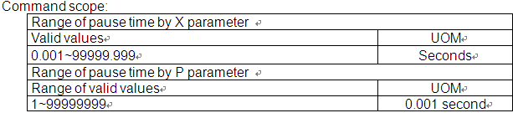
Формат команд G-кодов
G04: Pause Command
Формат команды:G04 Xˍ or G04 Pˍ
[Illustrations]
G04 X1.5 orG04 P1500
Both commands cause a pause span during program execution for 1.5 seconds.

Slide 28
Формат команд G-кодов
G10/G11: Data Entry Setup and Cancel
Формат команды:
G10 L2 Pˍ Xˍ Yˍ Zˍ
G10 L10 Pˍ Rˍ: Tool length compensation
G10 L11 Pˍ Rˍ: Tool length wear compensation
G10 L12 Pˍ Rˍ: Tool radius compensation
G10 L13 Pˍ Rˍ: Tool radius wear compensation
G10 L20 Pˍ Xˍ Yˍ Zˍ: Expansive workpiece coordinate system entry
In absolute status(G90):
the G10 command is the absolute input.
In incremental status(G91):
the G10 command input the value in incremental way.

Slide 29
Формат команд G-кодов
[Illustrations]
G10 L10 P1 R-300.0 or
G10 L10 P2 R-100.0
Set length compensation value of Tool 1 to H-300.0 and H-100.0 for Tool 2.
P: Compensation number or workpiece coordinate number
R: Tool compensation value
The examples of absolute and incremental status are as followings:
G90 G10 L10 P1 R-300.0
Input the data to H-300.0 of Tool 1 in absolute way.
G91 G10 L10 P1 R-100.0
Input the data to Tool 1 and add H-100.0 to it in incremental way.

Slide 30
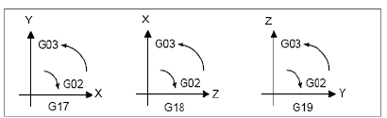
Формат команд G-кодов
G17/G18/G19: Plane Designation Command
Формат команды:
X - Y plane G17 {G01~G03} Xˍ Yˍ{Iˍ Jˍ or Rˍ}Fˍ
Z - X plane G18 {G01~G03} Zˍ Xˍ{Kˍ Iˍ or Rˍ}Fˍ
Y - Z plane G19 {G01~G03} Yˍ Zˍ{Jˍ Kˍ or Rˍ}Fˍ

Slide 31
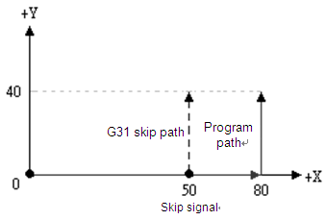
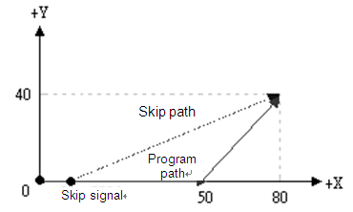
Формат команд G-кодов
G31: Skip Function Command
Формат команды: G31 Xˍ Yˍ Zˍ Fˍ
[Illustration 1]
G90 G00 X0 Y0
G01 G31 X80.0 F500.0
Y40.0
[Illustration 1]
G90 G00 X0 Y0；
G01 G90 G31 X50.0 F150.0；
X80.0 Y40.0；

Slide 32
Формат команд G-кодов
G43/G44: Tool Length Compensation Command
Формат команды:G43 Zˍ Hˍ
G44 Zˍ Hˍ
G43: Tool length positive compensation.
For positive tool length the tool axis moves in the positive direction.
G44: Tool length negative compensation.
For negative tool length the tool axis moves in the negative direction.
G49: Tool Length Compensation Cancelling Command
Формат команды:G49

Slide 33
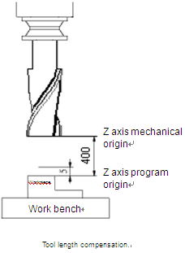
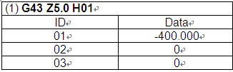
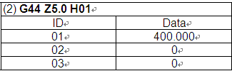
Формат команд G-кодов
[Illustrations] Tool length compensation setup

Slide 34
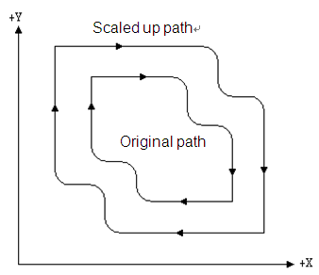
Формат команд G-кодов
G50 /G51: Scaling Up/Down Command/Cancelling Command指令格式：Формат команды:G51 Xˍ Yˍ Zˍ Pˍ
Xˍ Yˍ Zˍ: Coordinates center for scaling
Pˍ0: Scaling ratio

Slide 35
Формат команд G-кодов
G53： Mechanical Coordinate System Setup Command
Формат команды:G53 Xˍ Yˍ Zˍ
Xˍ Yˍ Zˍ: Position of actually arrived mechanical coordinates
Command description: Coordinates X, Y, and Z are the actual ending point in mechanical coordinates system specified by the program coordinates. Machine suppliers use this command to set up the tool replacement position with the reference point given in mechanical coordinates.
Note:
(1) Command G53 functions only at G90 status. It is ignored in G91 mode. However, a status command contained in the same statement of G53, G00/G01 or G90/G91, changes the status and affects the motion status of the next node.
(2) If the statement containing command G53 also contains a specific axial command, then the axis moves to a specified point. Otherwise, there is no position command.
(3) If both commands G53 and G28 are set in the same statement, the one read later becomes active. When command G53 is active, the motion position refers to the mechanical coordinates. If command G28 is active, then the absolute
coordinates are referred to.

Slide 36
Формат команд G-кодов
(4) A correct specified coordinate is needed in G53 Формат команды. G53 has to connect to the specified coordinate. Any other G command is not allowed to insert in the single node command so as to prevent the incorrectness of the
motion command.
For example,
G90 G00 G53 X10.0 Y10.0 Z-20.0------------------(Correct command combination)
G90 G53 G00 X10.0 Y10.0 Z-20.0----------------(Incorrect command combination)
Example 1.
G91G53X150.Y-150. →This command is ignored.
X-30.Y-30. →This command is changed to incremental motion mode.
Example 2.
G90G53X50.Y-50.Z0. → Move to X50.Y-50.Z0. in actual mechanical coordinates.
Example 3.
G1G53X100.Y-100.F1000 → This command executes in G00 status.
X50.Y50. → The system moves in G01F1000 motion status.

Slide 37
Формат команд G-кодов
G73: Peck Drilling Cycle Command
Формат команды:G73 Xˍ Yˍ Zˍ Rˍ Qˍ Fˍ Kˍ Dˍ
Xˍ Yˍ: Ending position of single step
Zˍ: Bottom of hole to be drilled
Rˍ: Initial safety height
Qˍ: Depth of each peck drilling
Fˍ: Feed rate
Kˍ: Number of cutting loops
Dˍ: Amount of retraction d after each cut
Command description: This command sets the machine to retreat a constant distance "d“ after drilling a distance (depth) of "Q" and keeps on drilling to the desired hole depth of "Z".
The back-and-forth intermittent Z-axis feeding enables easier chip dispelling during drilling deep hole.

Slide 38
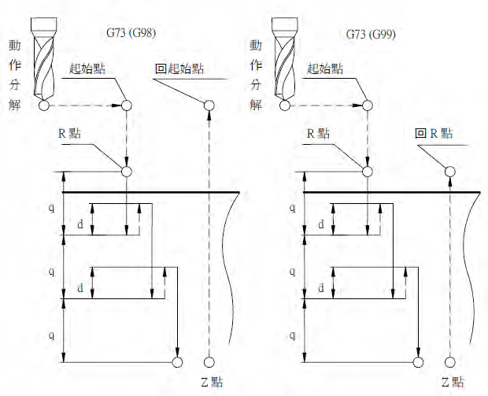
Формат команд G-кодов

Slide 39
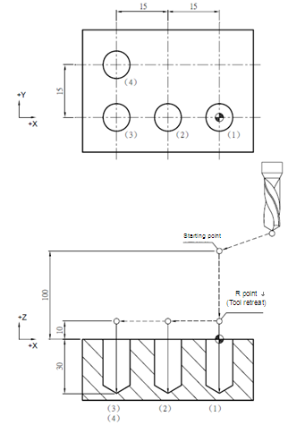
Формат команд G-кодов
[Illustrations]
M03 S1000;
G17 G90 G00 G54 X0. Y0.;
G00 Z100.;
G99 G73 X0. Y0. Z-30. R10. Q4. K1 F100 .--- （1）
X-15.;------------------------------- （2）
X-30.;------------------------------- （3）
X-30. Y15.; -------------------------（4）
G80 G91 G28 X0. Y0. Z0.;
M05;
39

Slide 40
Формат команд G-кодов
G80: Cycle Cancelling Command
Формат команды: G80
[Illustrations]
G17 G90 G00 G54 X0. Y0.;
Z100.;
G99 G73 X0. Y0. Z-20. R10. Q4. K1 F100.;
G80; ---------------------(Cancel cycles set by command G73)
G17 G90 G00 G54 X0. Y0.;
Z100.;

Slide 41
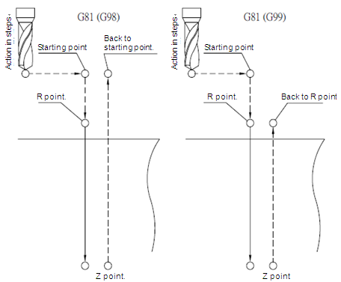
Формат команд G-кодов
G81: Drilling Cycle Command
Формат команды:G81 Xˍ Yˍ Zˍ Rˍ FˍKˍ
Xˍ Yˍ: Ending position of single step
Zˍ: Cutting depth position
Rˍ: Initial safety height
Fˍ: Feed rate
Kˍ: Number of cycles

Slide 42
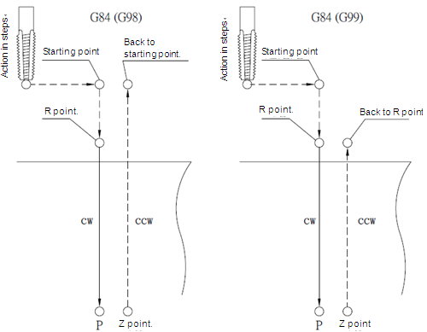
Формат команд G-кодов
G84： Right Spiral Tapping Cycle Command
Формат команды:G84 Xˍ Yˍ Rˍ Zˍ Pˍ Fˍ Kˍ
Xˍ Yˍ: Ending position of single step
Zˍ: Cutting depth position
Rˍ: Initial safety height
Pˍ: Pause time (in the least unit of 1/1000 second), without decimal point.
Fˍ: Spiral feed rate
Kˍ: Number of cycles
Notes:
G74: Left Spiral Tapping Cycle Command

Slide 43
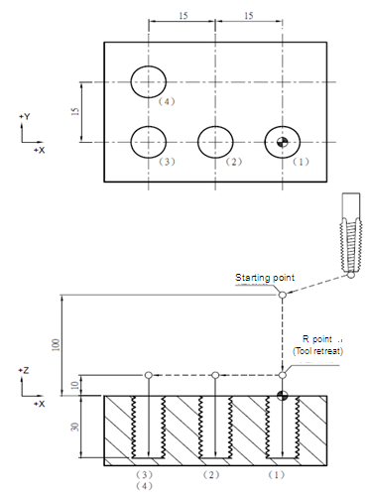
Формат команд G-кодов
[Illustrations]
G17 G90 G00 G54 X0. Y0.;
G00 Z100.;
M29 S1000;
G99 G84 X0. Y0. Z-30. R10. P1000 K1 F1000.; -- （1）
X-15.;-------------------------------------- （2）
X-30.;-------------------------------------- （3）
X-30. Y15.; ------------------------------ （4）
M28;
G80 G91 G28 X0. Y0. Z0.;
M05;

Slide 44
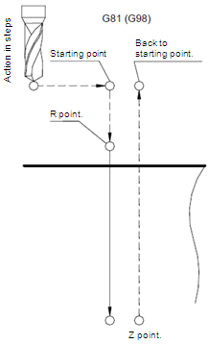
Формат команд G-кодов
G98: Return to the Initial Point of the Fixed Cycle
Формат команды:G98 G8_ Xˍ Yˍ Zˍ Rˍ Fˍ

Slide 45
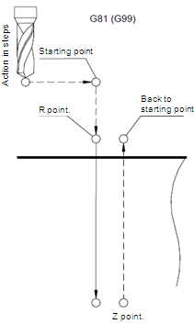
Формат команд G-кодов
G99: Return to the R Point of the Fixed Cycle Формат команды:G99 G8_ Xˍ Yˍ Zˍ Rˍ Fˍ

Slide 46
СПАСИБО
ЗА ВНИМАНИЕ!
Больше информации на сайте http://www.rts.ua/rus/catshop/827/CNC/

